Slide 1

Dr. B.R. Ambedkar National Institute of Technology Jalandhar
Jalandhar(144008), Punjab
Password Lock FSM
Submitted to: Submitted by:
Group 6
Dr. Tarun Chaudhary Aditya (25904138)
Assistant Professor, ECE Mayank Verma (25904145)
NITJ, Jalandhar Sarthak Singhal (25204131)
Karthikeyan (25904141)
Pradhum Kumar (25904147)

Slide 2
Abstract
This project demonstrates how FSMs can create robust security applications with features like:
4-digit password entry system
Failed attempt tracking (3 attempts before lockout)
Automatic timeout reset
Timed unlock duration
Password change capability
Helps understand how to architect a state machine that handles complex sequential logic and security protocols.

Slide 3
Password Lock FSM
Password Lock FSM is a security mechanism that grants access to anything like device or may be doors/ lockers cars etc. only when the correct password is entered.
Widely used in digital security systems like electronic safes, electronic door locks, and embedded devices.
It ensures protection against unauthorized access.
At the heart of these systems lies a simple yet powerful concept:
Finite State Machine (FSM).

Slide 4
Finite State Machine
A Finite State Machine is a sequential logic model used to design systems that operate through a series of well-defined states. The system moves from one state to another based on input signals and predefined rules.
FSM consists of a finite number of states.
The system can be in only one state at a time.
State transitions occur when specific inputs or conditions are met.
Used to design control-oriented digital systems.

Slide 5
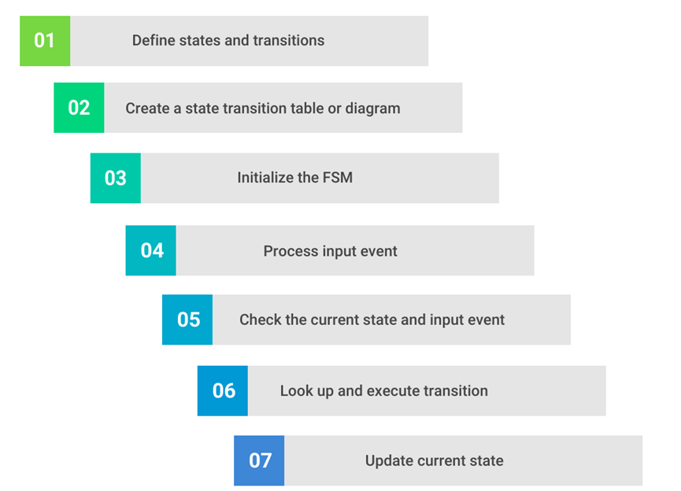
How FSM Works

Slide 6
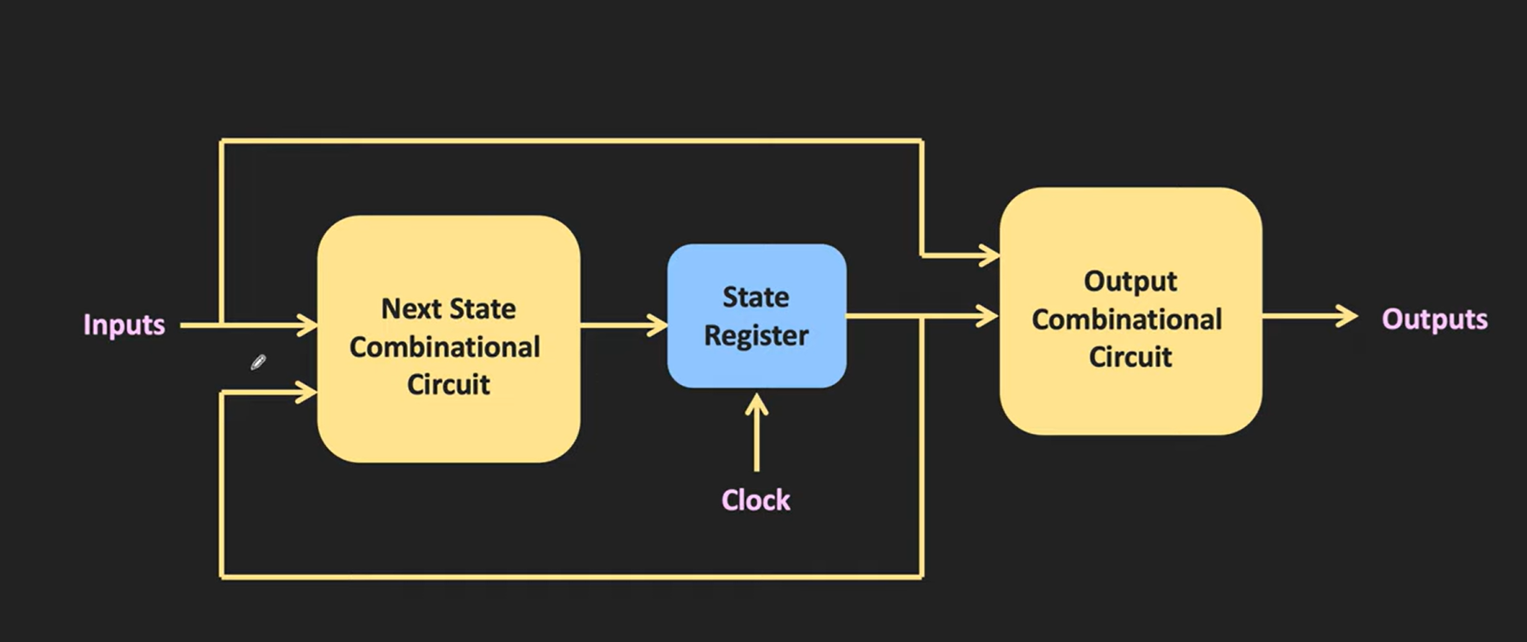
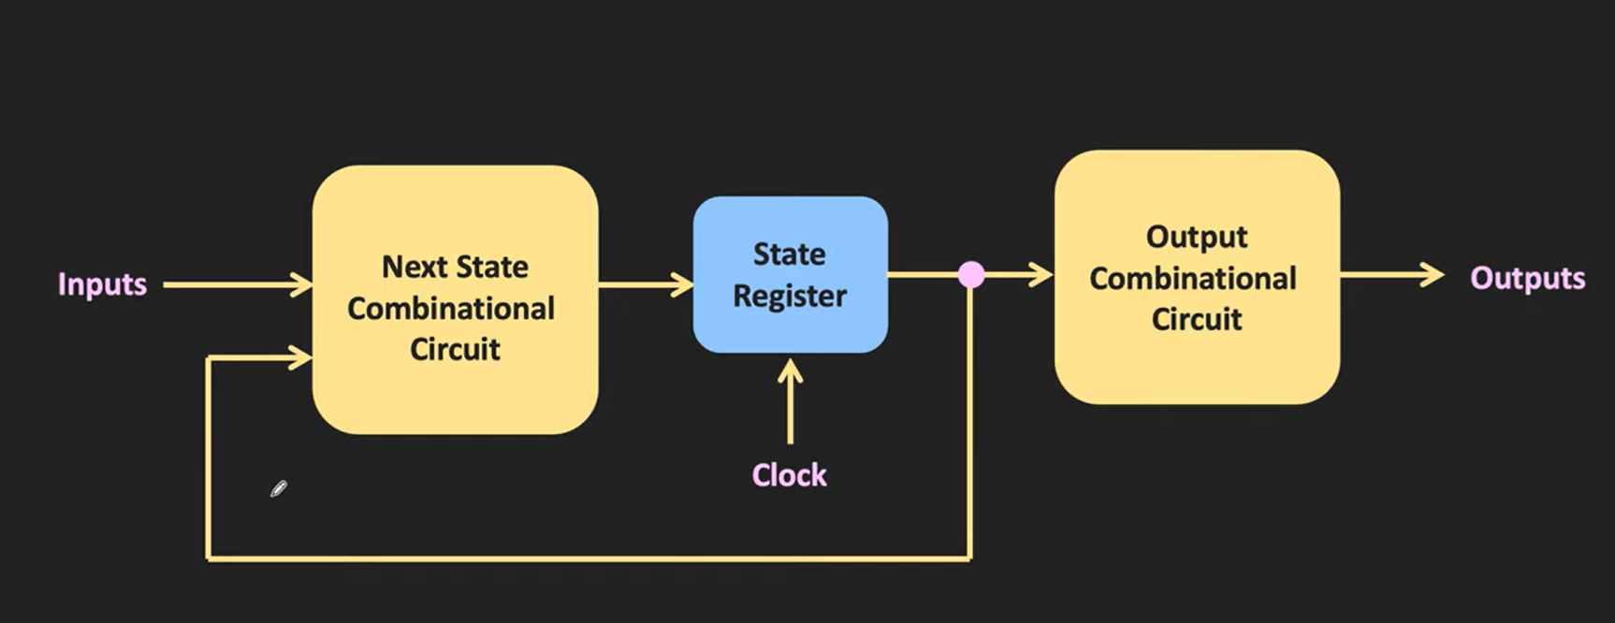
Types of FSM
Mealy Machine
Moore Machine

Slide 7
Why use FSM for Password Lock
FSM allows stepwise verification of input digits
Ensures deterministic behavior
Reliable for embedded security applications
Easy to Handle Wrong Inputs.
Supports Reset and Retry Logic
Simplifies Debugging and Simulation

Slide 8
System Architecture
1. Input Interface
Digit Input (4-bit)
Enter Button
Change Password Button
2. Edge Detection Module
Detect a clean rising pulse from the enter button.

Slide 9
System Architecture
3. FSM Controller
This is the core of the system.
States
IDLE: Initial locked state, waiting for first digit
DIGIT1-DIGIT4: Sequential digit entry states
CHECK_PASSWORD: Validates entered password against stored password
UNLOCKED: Door unlocked for 10 seconds
WRONG_PASSWORD: Increments failed attempt counter
LOCKED_OUT: System locked after 3 failed attempts
TIMEOUT: 30-second penalty before returning to IDLE
CHANGE_PASSWORD: Special mode for updating password
Responsibilities:
Controls system behaviour.
Moves sequentially from digit 1 → digit 4.
Triggers password checking.
Decides lock/unlock/error states.

Slide 10
System Architecture
4. Password Storage & Handling
a) Stored Password
b) Entered Password
5. Password Comparison Block
A parallel comparator checks the input and outputs
6. Attempt Counter Logic
Counts wrong attempts.
Max allowed attempts = 3.
7. Output Control Unit
Controls external indicators

Slide 11
Working
Top-level: An FSM implementing a 4-digit digital lock.
Inputs: clk, reset, digit_in (0–9), enter_btn, change_pwd_btn
Outputs: led (status), seg/an (7-seg), locked (1 = locked, 0= unlocked).
States: IDLE → DIGIT1 → DIGIT2 → DIGIT3 → DIGIT4 → CHECK_PASSWORD → UNLOCKED (or WRONG_PASSWORD / LOCKED_OUT).
DIGIT4 automatically proceeds to CHECK_PASSWORD.
Password storage: password[0:3] initialized to 1,2,3,4. Entered digits saved into entered_digits[0:3] on rising edges of enter_btn when in the corresponding DIGIT state.
Button edge detect: two-flip flop sampling of enter_btn creates enter_btn_rising (rising edge detection).
Password check: combinational compare of all four entered digits to stored password.
Attempt counting: attempt_count is intended to track failed tries and move to LOCKED_OUT after 3 attempts.

Slide 12

IDLE /
LOCKED
DIGIT 1
DIGIT 2
DIGIT 3
DIGIT 4
CHECK PASSWORD
UNLOCKED
LOCKED OUT
WRONG
PASSWORD

Slide 13
Security Features
Attempt Limiting: After 3 incorrect passwords, the system enters LOCKED_OUT state
Timeout Protection: Automatic reset if user takes too long between digits
Timed Unlock: Lock automatically re-engages after 10 seconds
Password Management: Secure password change mode with verification

Slide 14
Code
initial begin
password[0] = 4'd1;
password[1] = 4'd2;
password[2] = 4'd3;
password[3] = 4'd4;
attempt_count = 2'd0;
end
// SIMPLE BUTTON EDGE DETECTION
reg enter_btn_r1, enter_btn_r2;
wire enter_btn_rising;
always @(posedge clk or posedge reset) begin
if (reset) begin
enter_btn_r1 <= 1'b0;
enter_btn_r2 <= 1'b0;
end else begin
enter_btn_r1 <= enter_btn;
enter_btn_r2 <= enter_btn_r1;
end
end
assign enter_btn_rising = enter_btn_r1 && !enter_btn_r2;
// PASSWORD VERIFICATION
wire password_correct;
assign password_correct = (entered_digits[0] == password[0]) &&
(entered_digits[1] == password[1]) &&
(entered_digits[2] == password[2]) &&
(entered_digits[3] == password[3]);
// STATE REGISTER
always @(posedge clk or posedge reset) begin
if (reset)
current_state <= IDLE;
else
current_state <= next_state;
end
module digital_lock (
input wire clk,
input wire reset,
input wire [3:0] digit_in, // Input digit 0-9
input wire enter_btn, // Button to submit digit
input wire change_pwd_btn, // Button to change password
output reg [15:0] led, // Status LEDs
output reg [6:0] seg, // 7-segment display
output reg [7:0] an, // 7-segment anodes
output reg locked // Lock status (1=locked, 0=unlocked)
);
// STATE DEFINITIONS
localparam [3:0] IDLE = 4'd0;
localparam [3:0] DIGIT1 = 4'd1;
localparam [3:0] DIGIT2 = 4'd2;
localparam [3:0] DIGIT3 = 4'd3;
localparam [3:0] DIGIT4 = 4'd4;
localparam [3:0] CHECK_PASSWORD = 4'd5;
localparam [3:0] UNLOCKED = 4'd6;
localparam [3:0] WRONG_PASSWORD = 4'd7;
localparam [3:0] LOCKED_OUT = 4'd8;
reg [3:0] current_state, next_state;
// PASSWORD STORAGE
reg [3:0] password [0:3];
reg [3:0] entered_digits [0:3];
reg [1:0] attempt_count;

Slide 15
Code
UNLOCKED: begin
// Stay unlocked (manual reset to test)
next_state = UNLOCKED;
end
WRONG_PASSWORD: begin
// Manual return to IDLE for now
if (enter_btn_rising)
next_state = IDLE;
end
LOCKED_OUT: begin
// Manual return to IDLE for now
if (enter_btn_rising)
next_state = IDLE;
end
default: next_state = IDLE;
endcase
end
// DIGIT STORAGE - SIMPLIFIED
always @(posedge clk or posedge reset) begin
if (reset) begin
entered_digits[0] <= 4'd0;
entered_digits[1] <= 4'd0;
entered_digits[2] <= 4'd0;
entered_digits[3] <= 4'd0;
end else begin
if (current_state == IDLE && enter_btn_rising) begin
// When transitioning from IDLE to DIGIT1, store first digit
entered_digits[0] <= digit_in;
end
else if (current_state == DIGIT1 && enter_btn_rising) begin
// When transitioning from DIGIT1 to DIGIT2, store second digit
entered_digits[1] <= digit_in;
end
else if (current_state == DIGIT2 && enter_btn_rising) begin
// When transitioning from DIGIT2 to DIGIT3, store third digit
entered_digits[2] <= digit_in;
end
else if (current_state == DIGIT3 && enter_btn_rising) begin
// When transitioning from DIGIT3 to DIGIT4, store fourth digit
entered_digits[3] <= digit_in;
end
else if (current_state == UNLOCKED || current_state == WRONG_PASSWORD) begin
// Clear entered digits after checking
entered_digits[0] <= 4'd0;
entered_digits[1] <= 4'd0;
entered_digits[2] <= 4'd0;
entered_digits[3] <= 4'd0;
end
end
end
// NEXT STATE LOGIC - SIMPLIFIED (NO TIMEOUT)
always @(*) begin
next_state = current_state;
case (current_state)
IDLE: begin
if (enter_btn_rising)
next_state = DIGIT1;
end
DIGIT1: begin
if (enter_btn_rising)
next_state = DIGIT2;
end
DIGIT2: begin
if (enter_btn_rising)
next_state = DIGIT3;
end
DIGIT3: begin
if (enter_btn_rising)
next_state = DIGIT4;
end
DIGIT4: begin
// Automatically go to CHECK_PASSWORD after storing 4th digit
// No need to wait for another button press
next_state = CHECK_PASSWORD;
end
CHECK_PASSWORD: begin
if (password_correct)
next_state = UNLOCKED;
else if (attempt_count >= 2'd2)
next_state = LOCKED_OUT;
else
next_state = WRONG_PASSWORD;
end

Slide 16
Code
// ATTEMPT COUNTER
always @(posedge clk or posedge reset) begin
if (reset) begin
attempt_count <= 2'd0;
end else begin
if (current_state == UNLOCKED)
attempt_count <= 2'd0;
else if (current_state == WRONG_PASSWORD)
attempt_count <= attempt_count + 1;
end
end
// OUTPUT LOGIC
always @(posedge clk or posedge reset) begin
if (reset) begin
locked <= 1'b1;
led <= 16'h0000;
end else begin
case (current_state)
IDLE: begin
locked <= 1'b1;
led <= 16'h0001; // State 0
end
DIGIT1: begin
locked <= 1'b1;
led <= 16'h0002; // State 1
end
DIGIT2: begin
locked <= 1'b1;
led <= 16'h0004; // State 2
end
DIGIT3: begin
locked <= 1'b1;
led <= 16'h0008; // State 3
end
DIGIT4: begin
locked <= 1'b1;
led <= 16'h0010; // State 4
end
CHECK_PASSWORD: begin
locked <= 1'b1;
led <= 16'h0020; // State 5
end
UNLOCKED: begin
locked <= 1'b0;
led <= 16'hFFFF; // All on = unlocked!
end
WRONG_PASSWORD: begin
locked <= 1'b1;
led <= 16'h0040; // State 7
end
LOCKED_OUT: begin
locked <= 1'b1;
led <= 16'hAAAA; // Alternating
end
default: begin
locked <= 1'b1;
led <= 16'h0000;
end
endcase
end
end

Slide 17
7-SEGMENT DISPLAY
reg [15:0] refresh_counter = 0;
always @(posedge clk) begin
refresh_counter <= refresh_counter + 1;
end
wire [1:0] mux_select = refresh_counter[15:14];
function [6:0] encode7;
input [3:0] num;
case(num)
4'd0: encode7 = 7'b1000000;
4'd1: encode7 = 7'b1111001;
4'd2: encode7 = 7'b0100100;
4'd3: encode7 = 7'b0110000;
4'd4: encode7 = 7'b0011001;
4'd5: encode7 = 7'b0010010;
4'd6: encode7 = 7'b0000010;
4'd7: encode7 = 7'b1111000;
4'd8: encode7 = 7'b0000000;
4'd9: encode7 = 7'b0010000;
default: encode7 = 7'b1111111;
endcase
endfunction
always @(*) begin
case(mux_select)
2'b00: begin
an = 8'b11111110; // Digit 0 ON
seg = encode7(entered_digits[0]);
end
2'b01: begin
an = 8'b11111101; // Digit 1 ON
seg = encode7(entered_digits[1]);
end
2'b10: begin
an = 8'b11111011; // Digit 2 ON
seg = encode7(entered_digits[2]);
end
2'b11: begin
an = 8'b11110111; // Digit 3 ON
seg = encode7(entered_digits[3]);
end
endcase
end
endmodule

Slide 18
Testbench
// Test
initial begin
$display("\n========================================");
$display(" DIGITAL LOCK DEBUG SIMULATION");
$display("========================================");
$display("Password: 1-2-3-4");
$display("NO TIMEOUT - Pure state machine test\n");
// Init
reset = 1;
digit_in = 4'd0;
enter_btn = 0;
change_pwd_btn = 0;
#100;
reset = 0;
$display("%0t: Reset released", $time);
#100;
// TEST: Enter password digit by digit
$display("\n--- Entering Digit 1 ---");
digit_in = 4'd1;
#50;
$display("%0t: digit_in = %0d", $time, digit_in);
enter_btn = 1;
#20;
$display("%0t: enter_btn = 1", $time);
#100;
enter_btn = 0;
$display("%0t: enter_btn = 0", $time);
#200;
$display("%0t: State=%0d, LED=%h, entered[0]=%0d",
$time, uut.current_state, led, uut.entered_digits[0]);
$display("\n--- Entering Digit 2 ---");
digit_in = 4'd2;
module digital_lock_tb;
reg clk;
reg reset;
reg [3:0] digit_in;
reg enter_btn;
reg change_pwd_btn;
wire [15:0] led;
wire [6:0] seg;
wire [7:0] an;
wire locked;
// Instantiate digital lock
digital_lock uut (
.clk(clk),
.reset(reset),
.digit_in(digit_in),
.enter_btn(enter_btn),
.change_pwd_btn(change_pwd_btn),
.led(led),
.seg(seg),
.an(an),
.locked(locked)
);
// Clock - 100MHz
initial begin
clk = 0;
forever #5 clk = ~clk;
end

Slide 19
Testbench
#500;
$display("\n========================================");
$display("FINAL RESULTS:");
$display(" State = %0d (should be 6=UNLOCKED)", uut.current_state);
$display(" Locked = %b (should be 0)", locked);
$display(" LED = %h (should be FFFF)", led);
$display(" Password = %0d-%0d-%0d-%0d",
uut.password[0], uut.password[1],
uut.password[2], uut.password[3]);
$display(" Entered = %0d-%0d-%0d-%0d",
uut.entered_digits[0], uut.entered_digits[1],
uut.entered_digits[2], uut.entered_digits[3]);
if (locked == 0) begin
$display("\n*** SUCCESS! Lock is UNLOCKED! ***");
end else begin
$display("\n*** FAILED! Lock is still locked ***");
$display("Debug info:");
$display(" enter_btn_r1 = %b", uut.enter_btn_r1);
$display(" enter_btn_r2 = %b", uut.enter_btn_r2);
$display(" enter_btn_rising = %b", uut.enter_btn_rising);
end
$display("========================================\n");
#10000;
$finish;
end
// Monitor every state change
always @(uut.current_state) begin
$display("%0t: >>> STATE CHANGED to %0d <<<", $time, uut.current_state);
end
// Monitor edge detection
always @(posedge clk) begin
if (uut.enter_btn_rising)
$display("%0t: !!! BUTTON EDGE DETECTED !!!", $time);
end
endmodule
#50;
$display("%0t: digit_in = %0d", $time, digit_in);
enter_btn = 1;
#20;
$display("%0t: enter_btn = 1", $time);
#100;
enter_btn = 0;
$display("%0t: enter_btn = 0", $time);
#200;
$display("%0t: State=%0d, LED=%h, entered[1]=%0d",
$time, uut.current_state, led, uut.entered_digits[1]);
$display("\n--- Entering Digit 3 ---");
digit_in = 4'd3;
#50;
$display("%0t: digit_in = %0d", $time, digit_in);
enter_btn = 1;
#20;
$display("%0t: enter_btn = 1", $time);
#100;
enter_btn = 0;
$display("%0t: enter_btn = 0", $time);
#200;
$display("%0t: State=%0d, LED=%h, entered[2]=%0d",
$time, uut.current_state, led, uut.entered_digits[2]);
$display("\n--- Entering Digit 4 ---");
digit_in = 4'd4;
#50;
$display("%0t: digit_in = %0d", $time, digit_in);
enter_btn = 1;
#20;
$display("%0t: enter_btn = 1", $time);
#100;
enter_btn = 0;
$display("%0t: enter_btn = 0", $time);
#200;
$display("%0t: State=%0d, LED=%h, entered[3]=%0d",
$time, uut.current_state, led, uut.entered_digits[3]);

Slide 20
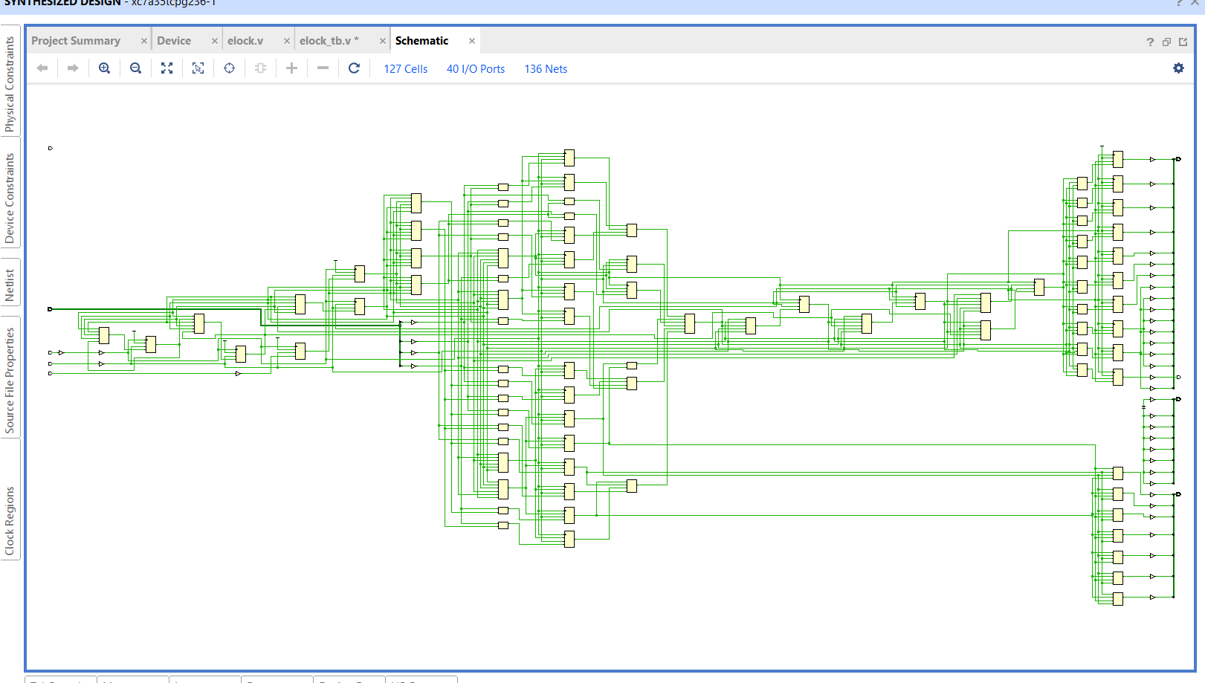
Schematic

Slide 21
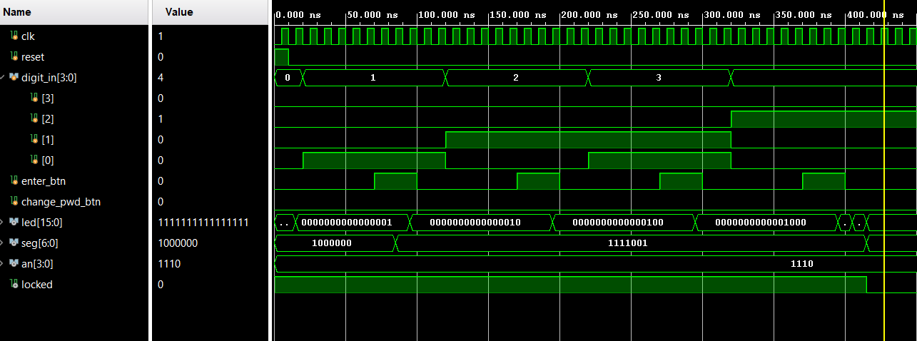
Simulation Results
4

Slide 22
Real Life Applications
This FSM design pattern is used in:
Electronic Door Locks: Hotel rooms, office buildings
Safe Systems: Bank vaults, home safes
Vehicle Immobilizers: Keyless entry systems
ATM Machines: PIN verification systems
Access Control: Server rooms, data centres

Slide 23
Thank You

